Slide 1
Mobile Application Development
David Drohan (ddrohan@wit.ie)

Slide 2

AndroidX Navigation Component

Slide 3
Agenda
Overview
Navigation Component Key Parts
Component Benefits
Navigation Drawers

Slide 4
Overview – AndroidX & Jetpack
AndroidX is the open-source project that the Android team uses to develop, test, package, version and release libraries within Jetpack
Jetpack is a suite of libraries, tools, and guidance to help developers write high-quality apps easier. These components help you follow best practices, free you from writing boilerplate code, and simplify complex tasks, so you can focus on the code you care about
Navigation is just one small component of these libraries!

Slide 5
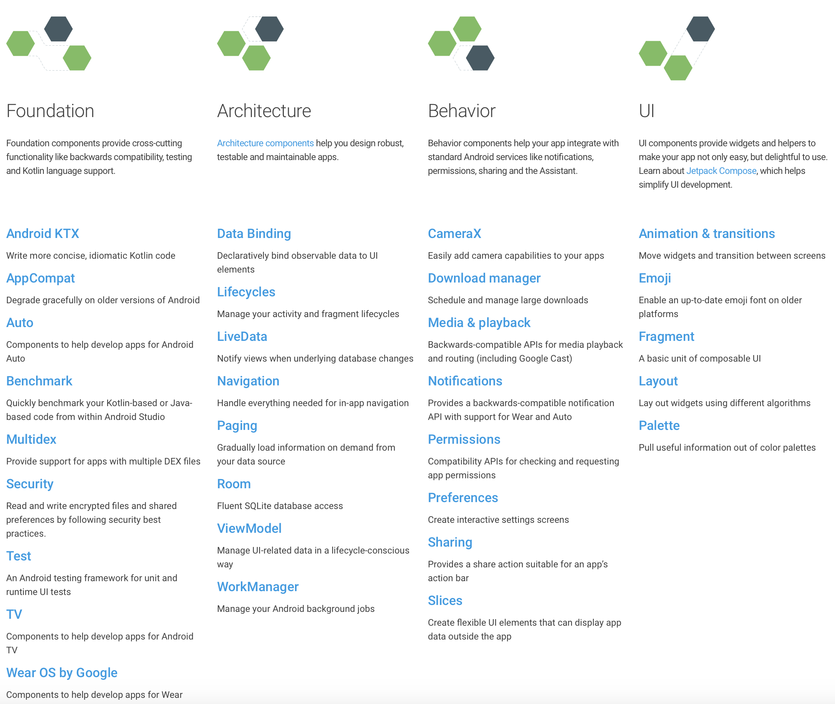
Overview – AndroidX & Jetpack

Slide 6
Overview – Navigation
Navigation refers to the interactions that allow users to navigate across, into, and back out from the different pieces of content within your app
Android Jetpack's Navigation component helps you implement navigation, from simple button clicks to more complex patterns, such as app bars and the navigation drawer
The Navigation component also ensures a consistent and predictable user experience by adhering to an established set of principles

Slide 7
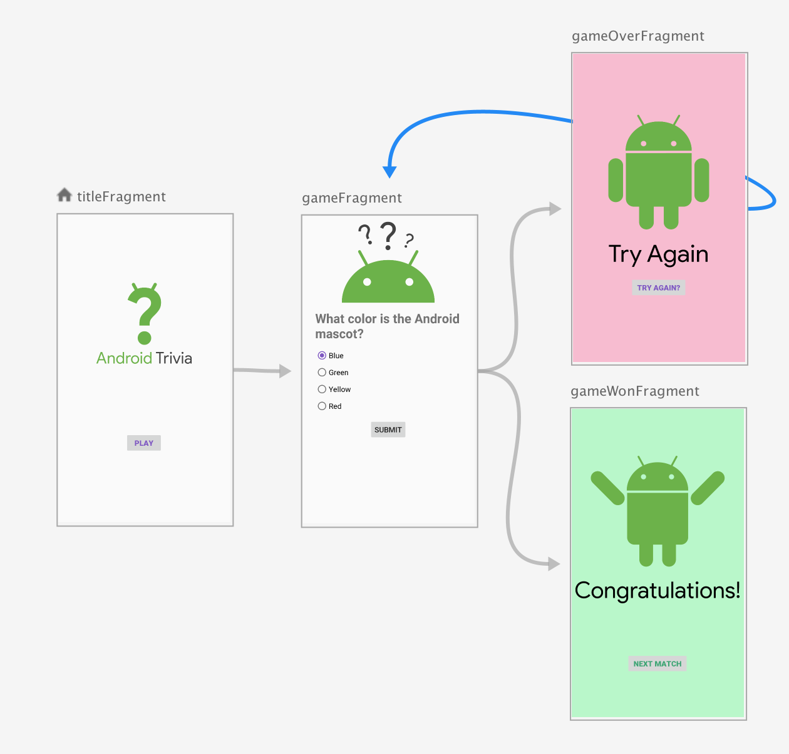
Navigation Component Key Parts
Navigation graph: An XML resource that contains all navigation-related information in one centralized location.
This includes all of the individual content areas within your app, called destinations, as well as the possible paths that a user can take through your app.

Slide 8
Navigation Component Key Parts
NavHost: An empty container that displays destinations from your navigation graph. The Navigation component contains a default NavHost implementation, NavHostFragment, that displays fragment destinations.
NavController: An object that manages app navigation within a NavHost. The NavController orchestrates the swapping of destination content in the NavHost as users move throughout your app.

Slide 9
Navigation Component Benefits
Handling fragment transactions
Handling Up and Back actions correctly by default
Providing standardized resources for animations & transitions
Implementing and handling deep linking
Including Navigation UI patterns, such as navigation drawers and bottom navigation, with minimal additional work
ViewModel support - you can scope a ViewModel to a navigation graph to share UI-related data between the graph's destinations

Slide 10
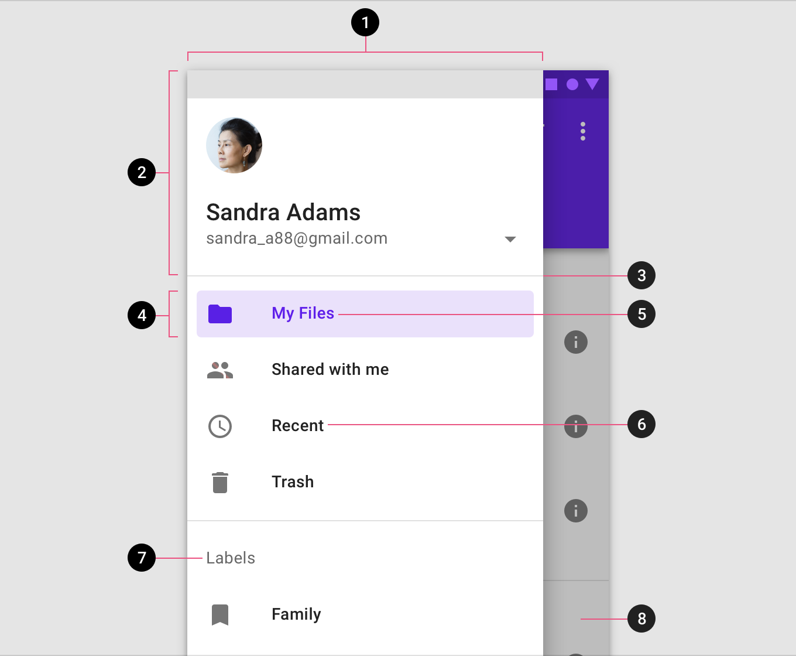

Navigation Drawer Overview

Slide 11
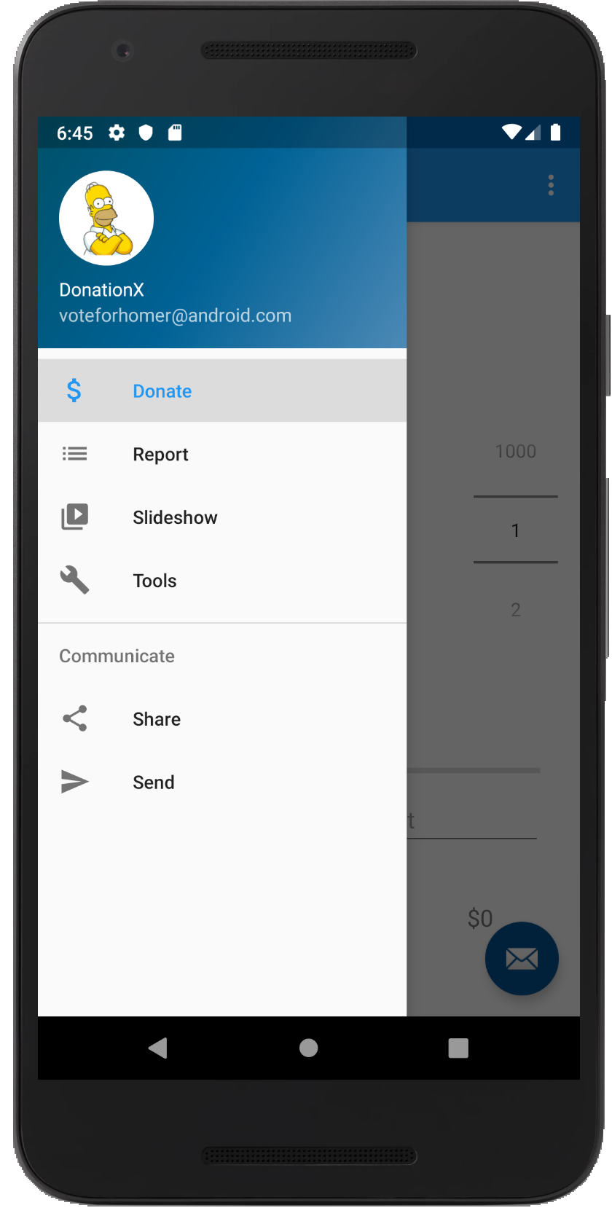
Navigation Drawer Overview
https://developer.android.com/training/implementing-navigation/nav-drawer.html
The navigation drawer is a panel that displays the app’s main navigation options on the left edge of the screen. It is hidden most of the time, but is revealed when the user swipes a finger from the left edge of the screen or, while at the top level of the app, the user touches the app icon in the action bar

Slide 12
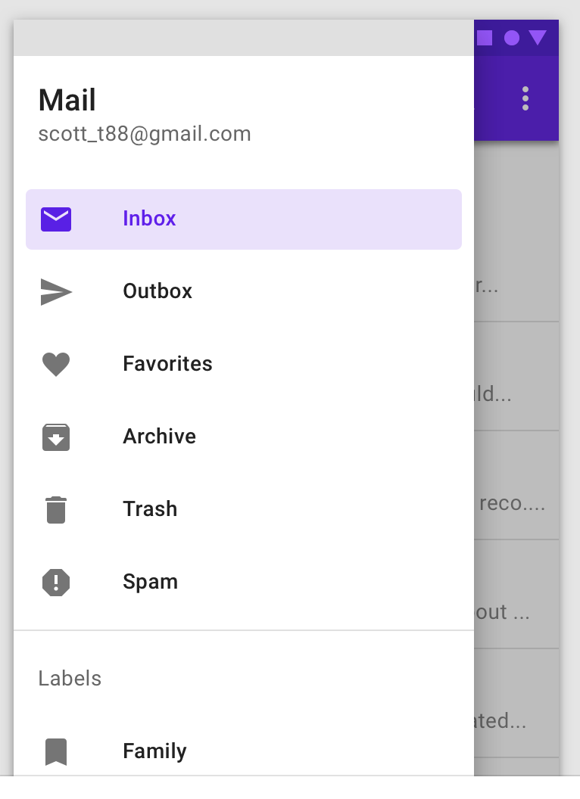
Navigation Drawer Overview
Navigation drawers are recommended for:
Apps with five or more top-level destinations *
Apps with two or more levels of navigation hierarchy
Quick navigation between unrelated destinations

Slide 13
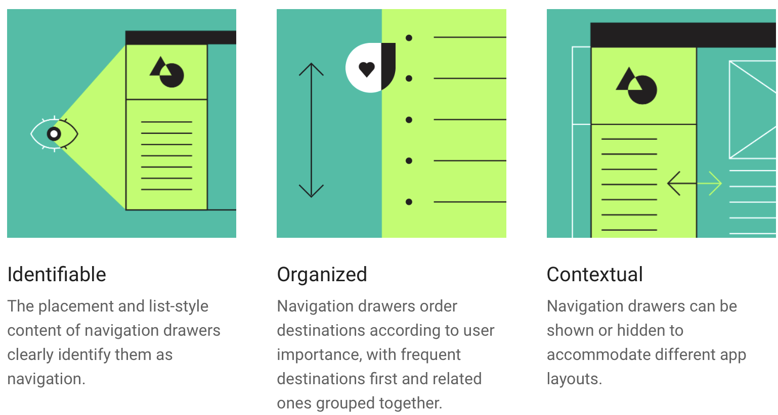
Navigation Drawer Principles

Slide 14
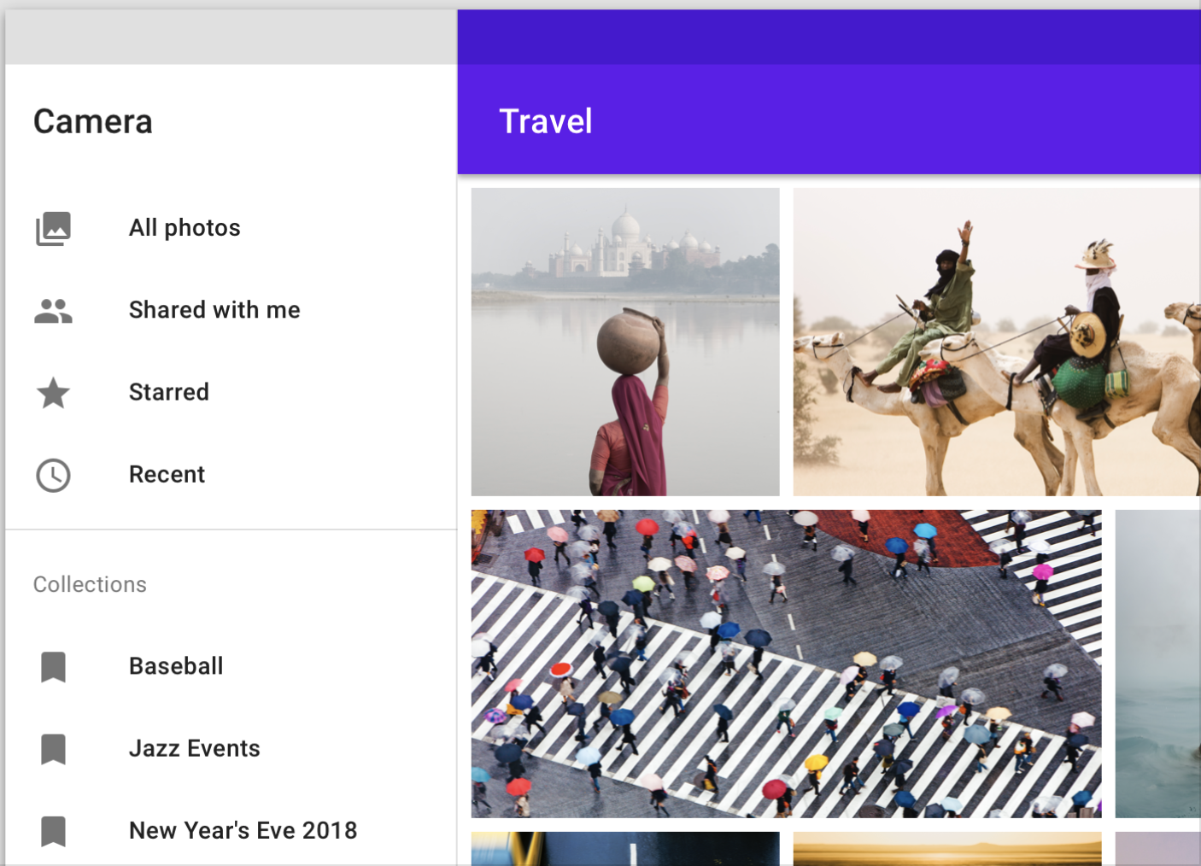
Nav Drawer Types
Standard
allow users to simultaneously access drawer destinations and app content. They are often co-planar with app content and affect the screen’s layout grid
can be permanently visible or opened and closed by tapping a navigation menu icon. They can be used on tablet and desktop only. On mobile, modal drawers are used instead

Slide 15
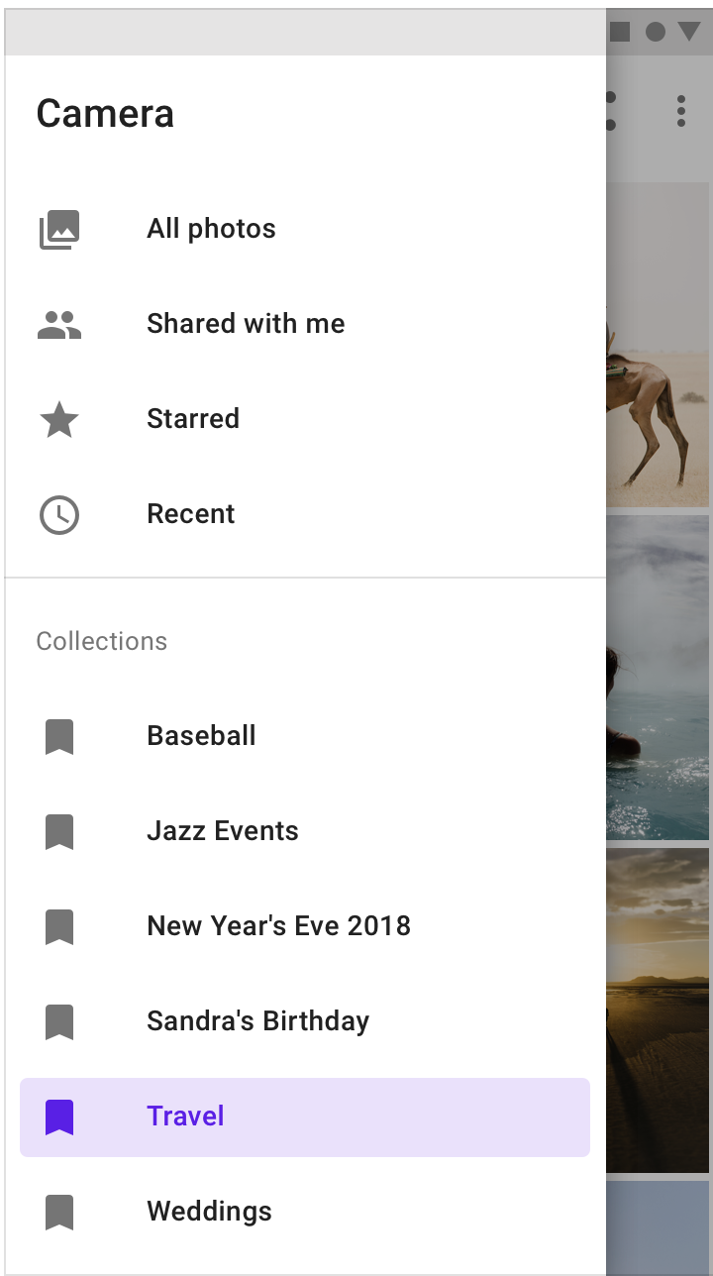
Nav Drawer Types
Modal
use a scrim to block interaction with the rest of an app’s content. They are elevated above most app elements and don’t affect the screen’s layout grid
primarily for use on mobile, where screen space is limited. They can be replaced by standard drawers on tablet and desktop

Slide 16
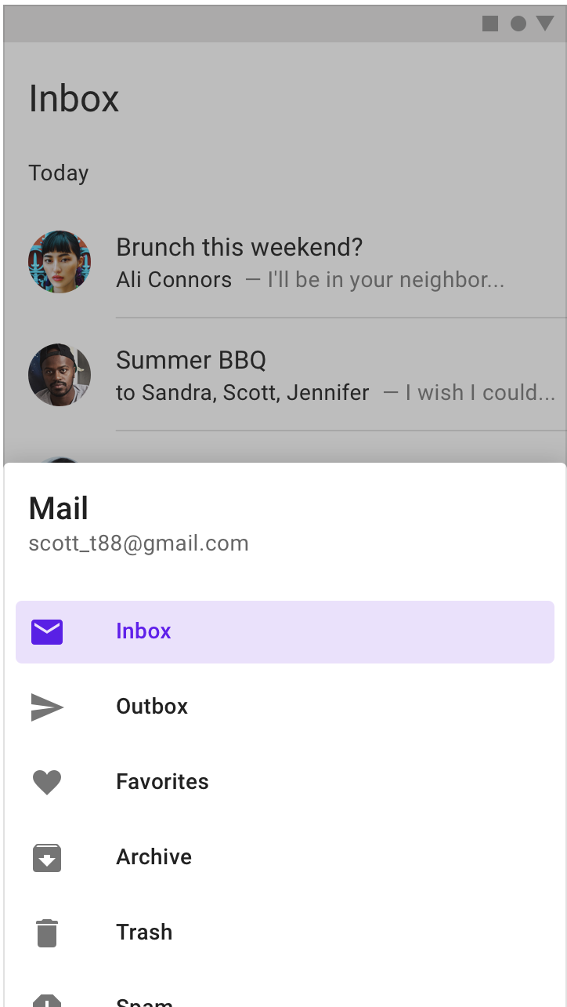
Nav Drawer Types
Bottom
are a specialized type of modal drawer for use with a bottom app bar
for increased reachability from the bottom app bar’s menu icon, they open from the bottom of the screen rather than the side

Slide 17
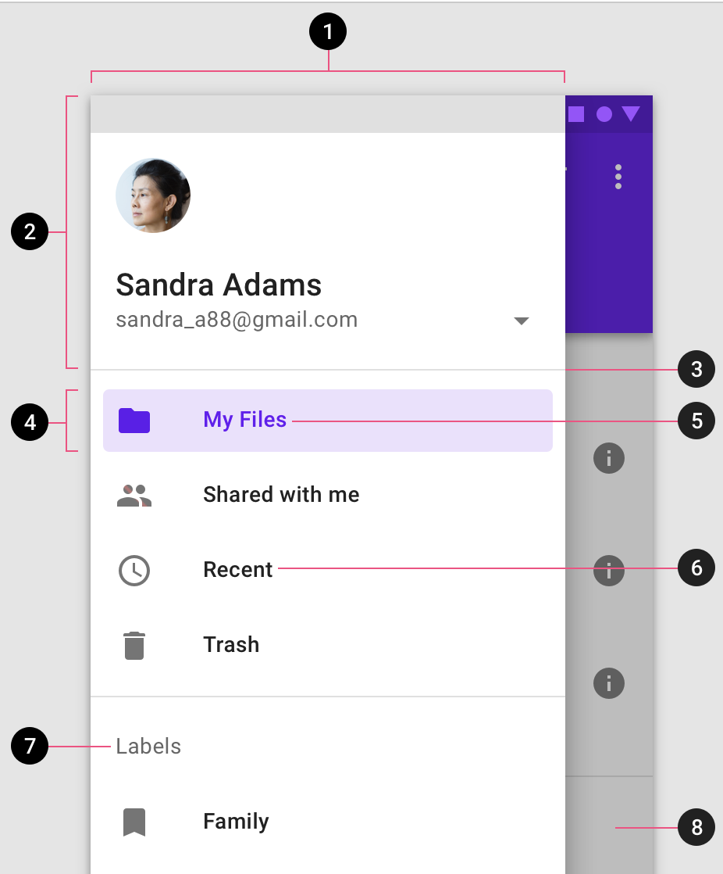
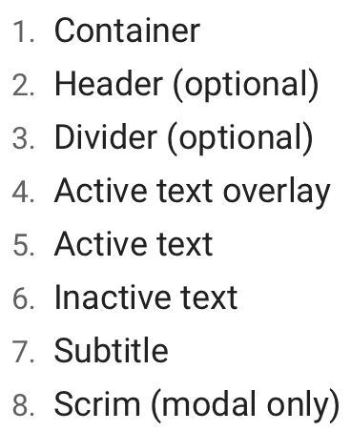
Nav Drawer Anatomy
contains a list embedded within a sheet
can be enhanced with headers and dividers to organize longer lists

Slide 18
Navigation Drawer & Fragments in Donation

Slide 19

References
Sources: https://blog.mindorks.com/android-navigation-drawer-in-kotlin
https://medium.com/@umang.burman.micro/navigation-drawer-with-navigation-component-4f032bfdeae6
https://developer.android.com/guide/navigation
https://medium.com/@myric.september/navigation-in-android-navigation-architecture-component-a1f103a6cc52
https://material.io/components/navigation-drawer/#

Slide 20


